Slide 1
AREA PROTECTION TURRET
EMRE CAN MADENCİ 200019472
EMRE MERT 200018014

Slide 2
CONTENTS
Introduction
What is the purpose of our project?
What is Area Protection Turret?
How its Work?
Methods
Design
Programming
Conclusion

Slide 3
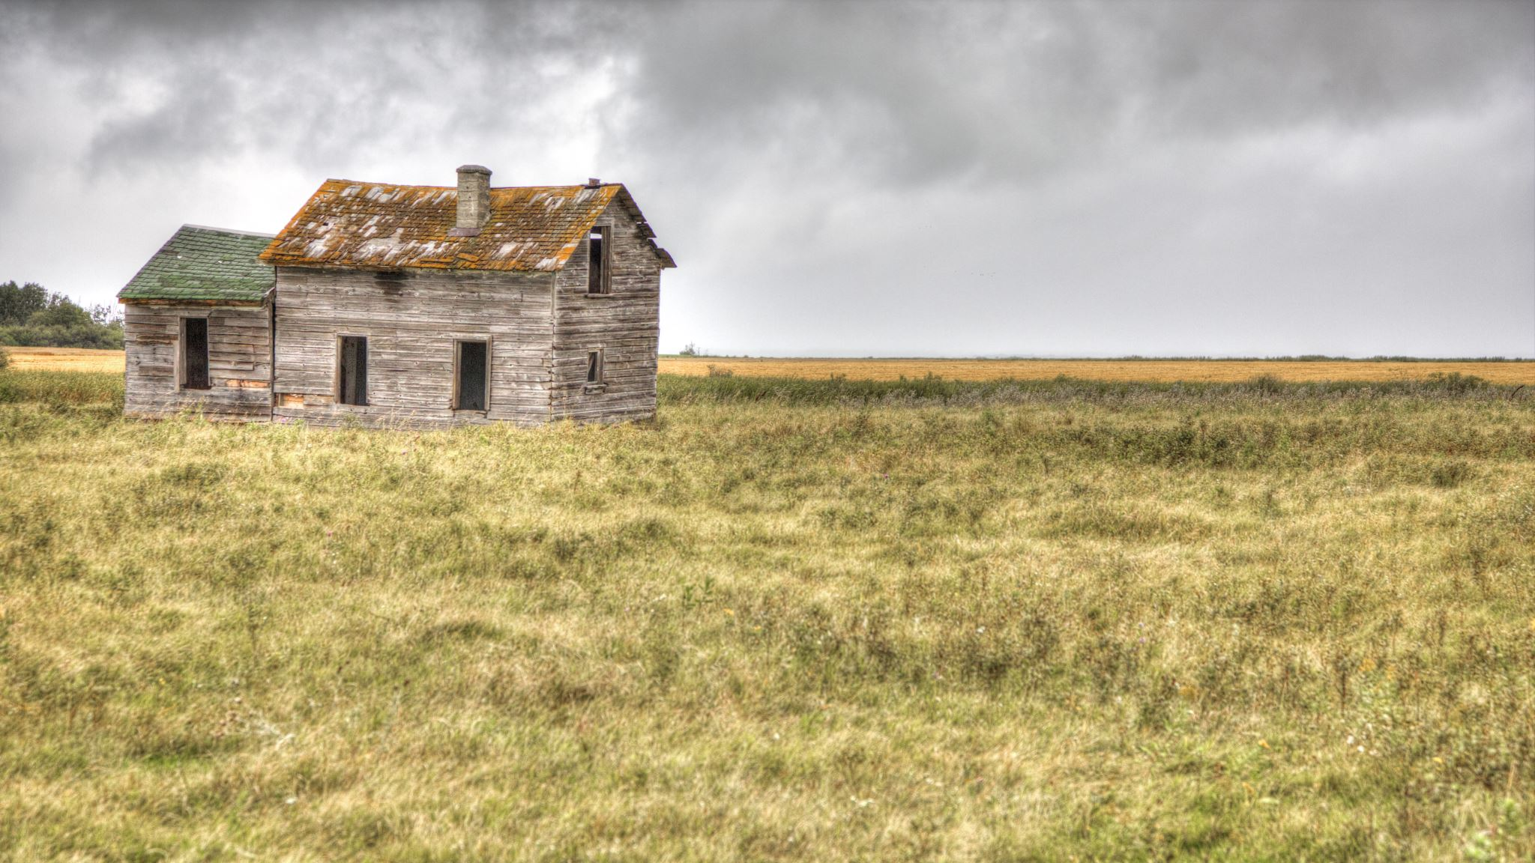
INTRODUCTION
Agriculture and animal husbandry have been fundamental to human civilizations since the dawn of settlement. However, these activities conducted in natural areas face constant threats. Imagine wild boars ravaging cornfields or sly foxes preying on defenseless chickens. Throughout history, farmers have devised various tools to combat these dangers, like placing honeycombs high in tree trunks to elude bears or surrounding fields with barbed wire fences.

Slide 4

What is the purpose of our project?
Our project aims to protect the area by deterring wild animals using sound and light, and to protect the owners of the area from material and physical damage.
It detects wild animals by monitoring the area with its camera. When a wild animal is detected, the turret turns in that direction and warns the animal with its sound and light alarm devices. These warnings disorient and scare the animal, deterring it from the area.

Slide 5
What is Area Protection Turret
In the natural world, wild animals can sometimes damage production facilities and residential areas such as fields, beehives, and country homes. This damage can lead to crop loss, property damage, and even injuries. To protect these areas from wild animals, defense turret can be used.

Slide 6
How its work?
Through its camera system, it detects animals in its surroundings and utilizes the YOLO (You Only Look Once) algorithm to identify and categorize them. This technology is designed to ensure the safety of designated areas by accurately and promptly classifying detected animal species. To deter these animals from the area, the system emits appropriate warning sounds, providing an effective method of deterrence. This system stands out as an innovative solution aimed at protecting both the animals and the designated area.

Slide 7

Methods
After trying various methods, we concluded that the current system is the most stable and functional. In our current system, the servo motor is controlled by Arduino and rotates in a specific sequence. The Raspberry Pi, on the other hand, processes the image from the camera mounted on the motor and triggers an alarm when it detects an animal.

Slide 8
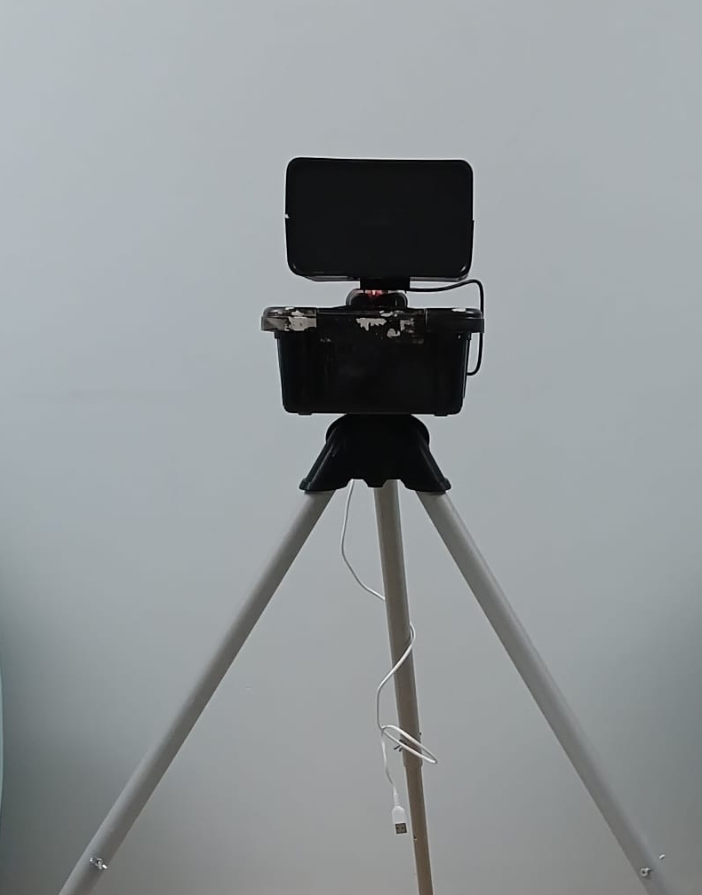
DESIGN
The design of our project is suitable for nature, sheltered, and can work without being damaged in the harsh conditions of nature. For this, there are various configurations available. It can vary depending on the environment, such as a fixed stand or tripod foot.
Place and use our system in natural habitats.

Slide 9

PROGRAMMING
Threats will be detected with the camera. Not only image capture is done with the camera, but also target tracking is also done. This ensures that the actions taken are directly targeted. For this, image processing and tracing will be used. In the program we will write, animals and humans will be introduced and their tracking will be done. In our system, there will be a powerful speaker source to deter targets. These will keep them away from the area we want to protect without harming them or the natural environment.

Slide 10
PROGRAMMING
We initially started developing the animal detection system using the YOLOv8 model. We created our custom dataset using the Roboflow platform and integrated the audio playback functionality into this dataset. For controlling our servo motor, we used a code in Arduino that runs in a loop with adjustable rhythm. The Arduino is powered by a Raspberry Pi, allowing the entire system to operate with a single power input.

Slide 11
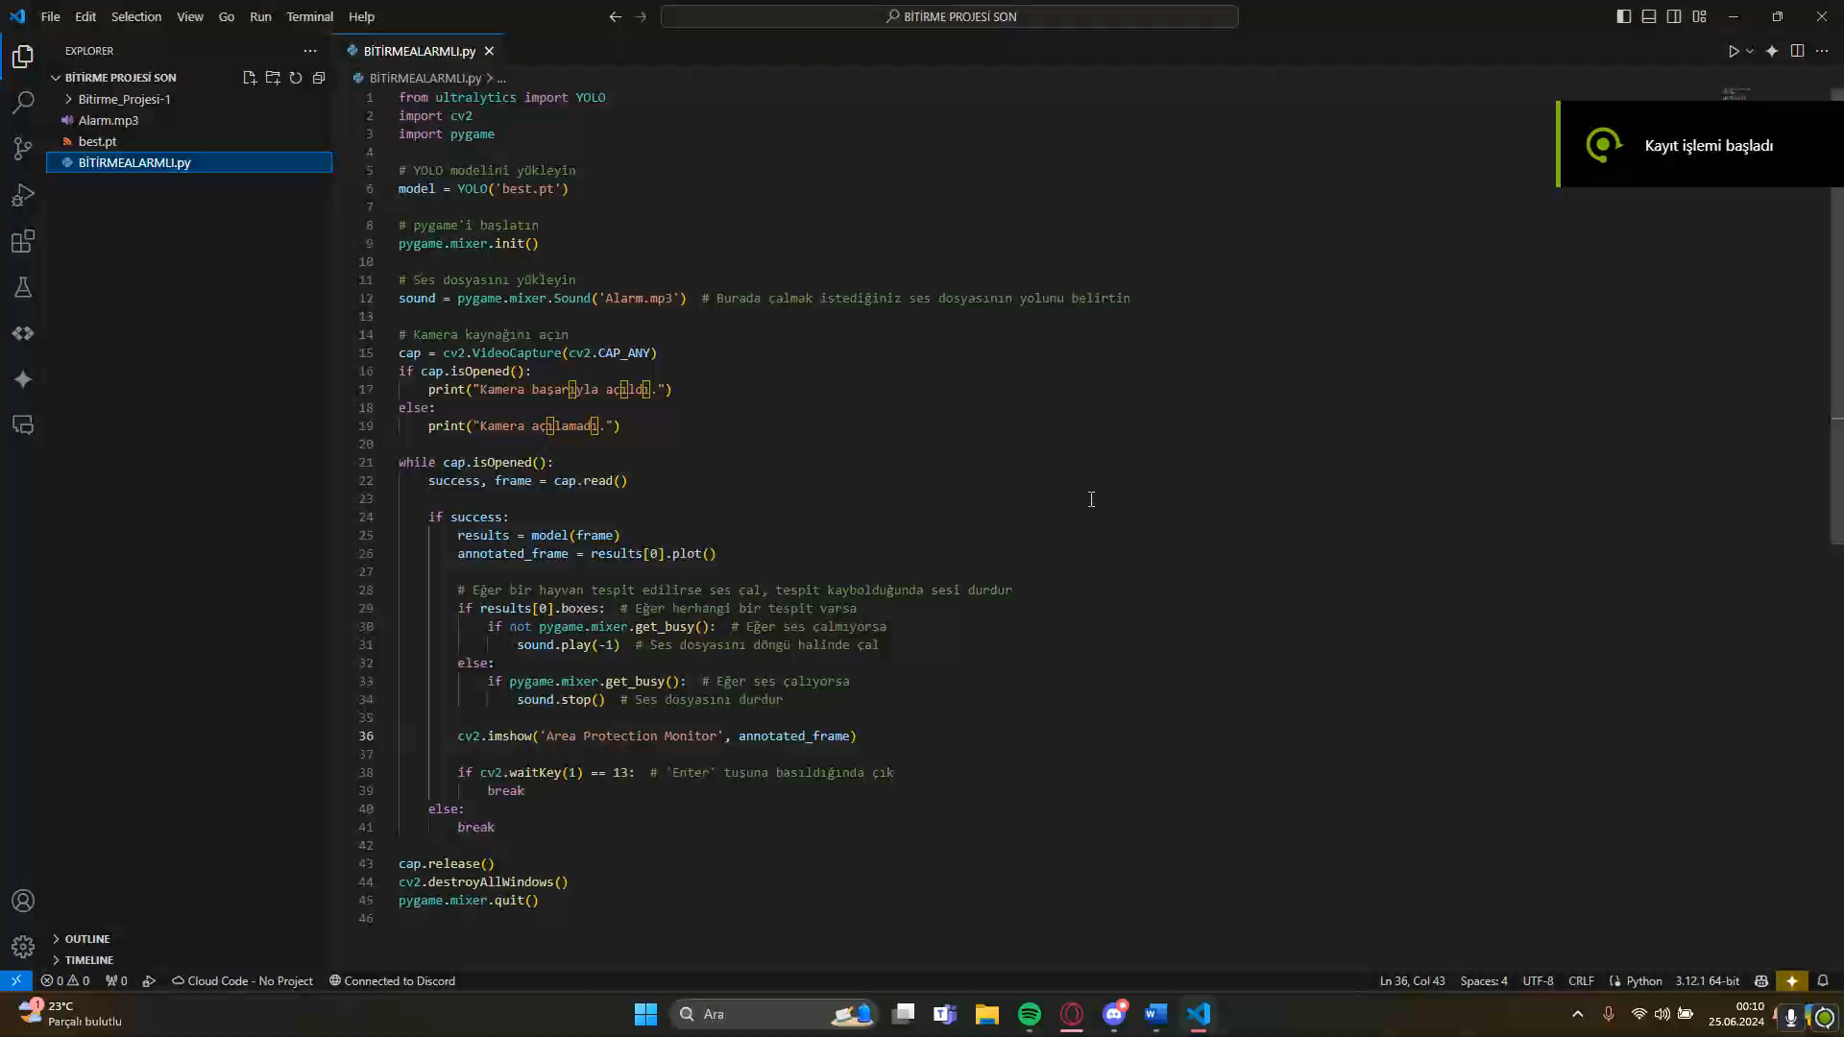

Slide 12
Thanks for Watching

